Slide 1
Embedded System Design
P.RAJESH
JNTUACEA
Ph: 9989786119

Slide 2
What to Learn ?..
current technologies, integration methods and hardware and software design concepts associated with processor in Embedded Systems .
A simple low power microcontrollers and their applications
The hardware software co- design issues pertaining to design of an Embedded System using low power microcontrollers

Slide 3
Introduction of Embedded Systems
Definition , Applications Life Cycle , Design Approach
Devices – Sensors , Actuators
Memory – ROM & RAM
ASIC , ASSP
Embedded Systems Devices
Firmware / Requirements
Reset , Brownout , Oscillators, Real time Clock ,
Design types of Languages
RealTime Operating Systems
RTOS
Kernel Services
Multi Process,
Multi tasking ,
Scheduling
Application Specified
Task Communication /
Task Synchronization

Slide 4
Embedded Systems
Def: A Embedded system is an Electrical / Electro mechanical system which specifically designed for an application .
Embedded system contains Processing unit which can be
MicroProcessor (or) MicroController /
system on chip (SOC)/
Application Specified Integrated Circuit (ASIC)/
Appilication Specific Standard product /Programmable Logic Device (PLD) like FPGA (or) CPLD and Input Output System which facilitates of sensors and actuators which acts like messenger from and to Real world.

Slide 5
Depending on the response of the system requirements and types of applications for which ES is designed , an Embedded can be Real time (or) Non Real time.
The response for Real time is Flight control system, Airbag Development system, Automotive ..etc..
Non Real time : Automatic Teller Machines (ATM), Media playback systems , etc.,

Slide 6
Introduction to Embedded Electronic Systems and Microcontrollers
Description of an Embedded System:
Embedded systems are more limited in hardware and/or software functionality than a personal computer (PC).
In terms of hardware limitations, this can mean limitations in processing performance, power consumption, memory, hardware functionality, and so forth.
In software, this typically means limitations relative to a PC—fewer applications, scaled-down applications, no operating system (OS) or a limited OS, or less abstraction-level code.

Slide 7
An embedded system is designed to perform a dedicated function. Most embedded devices are primarily designed for one specific function. Examples : personal data assistant (PDA)/cell phone hybrids, digital TVs include Examples of ES
Market | Embedded Device
Automotive | Ignition Systems
 | Engine Control
 | Brake System (i.e., Antilock Braking System)
Industrial Control | Robotics and Control Systems (Manufacturing)
 | Infusion Pumps, Dialysis Machines
 | Prosthetic Devices, Cardiac Monitors
Networking | Routers, Hubs, Gateways
Office Automation | Fax Machine Photocopier Printers Monitors Scanners

Slide 8
Consumer Electronics | Digital and Analog Televisions
 | Set-Top Boxes (DVDs, VCRs, Cable Boxes, etc.)
 | Personal Data Assistants (PDAs)
 | Kitchen Appliances (Refrigerators, Toasters, Microwave Ovens)
 | Automobiles
 | Toys/Games
 | Telephones/Cell Phones/Pagers Cameras
 | Global Positioning Systems (GPS)

Slide 9
Embedded Systems Design
Most of models are based upon one or some combination of the following development models:
The big-bang model, in which there is essentially no planning or processes in place before and during the development of a system.
The code-and-fix model, in which product requirements are defined but no formal processes are in place before the start of development.
The waterfall model, in which there is a process for developing a system in steps, where results of one step flow into the next step.
The spiral model, in which there is a process for developing a system in steps, and throughout the various steps, feedback is obtained and incorporated back into the process.

Slide 10
Design and Development Lifecycle Model
This model is based on a combination of the popular waterfall and spiral industry models.
four phases:
creating the architecture,
implementing the architecture,
testing the system,
maintaining the system.

Slide 11
Product concept
Preliminary Analysis of Requirements
Creation of Architecture Design
Develop version of Architecture
Deliver Final Version of Architecture
Incorporate Feedback
Deliver version Architecture
Development of the System
Review and obtain Feedback
Incorporate Feedback
Review & Test the system
Deliver and Maintain the System

Slide 12
An Introduction to Embedded Systems Architecture
Structure | Definition
1. Module | Elements (referred to as modules) are defined as the different functional components with in an embedded device. Marketing and sales architectural are typically represented as modular structures, since software or hardware is typically packaged for sale as modules (i.e., an operating system, a processor, a JVM, and so on).
Uses (also referred to as subsystem and component) | A type of modular structure representing system at runtime in which modules are inter-related by their usages
Layers | A type of Uses structure in which modules are organized in layers (i.e., hierarchical) in which modules in higher layers use modules of lower layers.

Slide 13
Structure | Definition
Kernel | Structure presents modules that use modules (services) of an operating system kernel or are manipulated by the kernel.
Channel Architecture | Structure presents modules sequentially, showing the module transformations through their usages.
Virtual Machine | Structure presents modules that use modules of a virtual machine.
Decomposition | A type of modular structure in which some modules are actually subunits (decomposed units) of other modules, and inter-relations are indicated as such. Typically used to determine resource allocation, project management (planning), data management (encapsulation, privatization, etc.).

Slide 14
Structure | Definition
Class (also referred to as generalization) | This is a type of modular structure representing software and in which modules are referred to as classes, and inter-relationships are defined according to the object-oriented approach in which classes are inheriting from other classes, Useful in designing systems with similar foundations.
2. Component and Connector | These structures are composed of elements that are either components (main hw/sw processing units, such as processors, a Java Virtual Machine, etc.) or connectors (communication mechanism that inter-connects components, such as a hw bus, or sw OS messages, etc.).

Slide 15
Structure | Definition
Client/Server (also referred to as distribution) | Structure of system at runtime where components are clients or servers (or objects), and connectors are the mechanisms used (protocols, messages, packets, etc.) used to intercommunicate between clients and servers (or objects).
Process (also referred to as communicating processes) | This structure is a SW structure of a system containing an operating system. Components are processes and/or threads and their connecters are the inter-process communication mechanisms (shared data, pipes, etc.) Useful for analyzing scheduling and performance.
Interrupt | Structure represents the interrupt handling mechanisms in system.

Slide 16
Scheduling (EDF, priority, round robin) | Structure represents the task scheduling mechanism of threads demonstrating the fairness of the OS scheduler.
Memory | This runtime representation is of memory and data components with the memory allocation and de allocation (connector) schemes—essentially the memory management scheme of the system.
Garbage Collection | This structure represents the garbage allocation scheme
Allocation | This structure represents the memory allocation scheme of the system (static or dynamic, size, and so on).

Slide 17
Safety and Reliability | This structure is of the system at runtime in which redundant components (hw and sw elements) and their inter communication mechanisms demonstrate the reliability and safety of a system in the event of problems (its ability to recover from a variety of problems).
3. Allocation | A structure representing relationships between sw and/or hw elements, and external elements in various environments.
Work Assignment | This structure assigns module responsibility to various development and design teams. Typically used in project management.
Implementation | This is a sw structure indicating where the sw is located on the development system’s file system.

Slide 18
The Embedded Systems Model
The foundation for architectural structures used architectural tools (i.e., reference models).
Application Software Layer
(Optional )
System Software Layer
(Optional )
Hardware Layer
(Required )

Slide 19
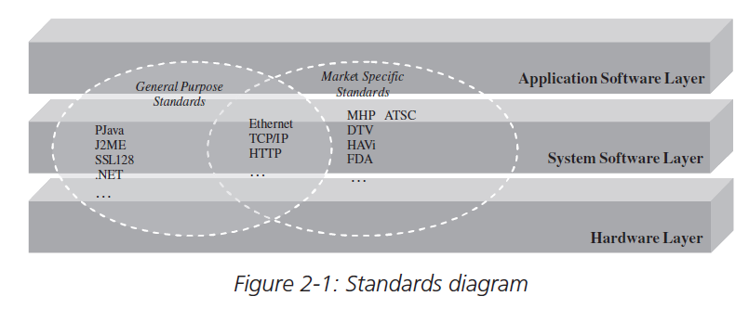

Slide 20
Embedded Systems Model indicates that all embedded systems share one similarity at the highest level;
-- that is, they all have at least one layer (hardware) or all layers (hardware, system software and application software) into which all components fall.
The hardware layer contains all the major physical components located on an embedded board.
system and application software layers contain all of the software located on and being processed by the embedded system.

Slide 21
Modular representation of embedded systems architecture as the primary structure.
1. The visual representation of the main elements and their associated functions.
The layered approach allows readers to visualize the various components of an embedded system and their interrelationship.
2. Modular architectural representations are typically the structures leveraged to structure the entire embedded project.
This is mainly because the various modules (elements) within this type of structure are usually functionally independent.
These elements also have a higher degree of interaction, thus separating these types of elements into layers improves the structural organization of the system without the risk of oversimplifying complex interactions.

Slide 22
Standard Type |  | Standard | Purpose
Market Specific | Consumer Electronics | Java TV | The Java TV API is an extension of the Java platform that provides access to functionality unique to a DTV receiver, such as audio video streaming, conditional access, access to in-band and out-of band data channels, access to service information data, tuner control for channel changing, on-screen graphics control, media synchronization
 |  | DVB (Digital Video Broadcasting)—MHP (Multimedia Home Platform) | The Java-based standard used in DTV designs introduces components in the system software layer, as well as provides recommendations for hardware and the types of applications compatible with MHP. The MHP extends the existing DVB open standards for broadcast and interactive services in all transmission networks including satellite, cable, terrestrial, and microwave systems.

Slide 23
Standard Type |  | Standard | Purpose
Market Specific | Consumer Electronics | ATSC (Advanced Television Standards Committee)—DASE (Digital TV Applications Software Environment) | The DASE defines a system software layer that allows programming content and applications to run on a “common receiver.” Interactive and enhanced applications need access to common receiver features in a platform independent manner. Data will run uniformly on all brands and models of receivers.
 |  | HAVi (Home Audio Video Initiative) | HAVi provides a home networking standard between digital audio and video consumer devices, allowing all audio and video appliances within the network to interact with each other, and allow functions on one or more appliances to be controlled from another appliance, regardless of the network configuration and appliance manufacturer.

Slide 24
Standard Type |  | Standard | Purpose
Market Specific | Medical devices | Food and Drug Administration (US) | US government standards for medical devices relating to the aspects of safety and/or effectiveness of the device.
 |  |  | Class I devices are defined as non-life-sustaining. These products are the least complicated and their failure poses little risk.
 |  |  | Class II devices are more complicated and present more risk than Class I, though are also non-life-sustaining.
 |  |  | Class III devices sustain or support life, so that their failure is life threatening. Standards include areas of anesthesia

Slide 25
Standard Type |  | Standard | Purpose
Market Specific | Networking and Communications | TCP (Transmission Control Protocol)/IP (Internet Protocol) | Protocol stack based on RFCs 791 (IP) & 793 (TCP) that define system software components
 |  | PPP (Point-to-Point Protocol) | System software component based on RFCs 1661, 1332, and 1334
 |  | IEEE (Institute of Electronics and Electrical Engineers) 802.3 Ethernet | Networking protocol that defines hardware and system software components for LANs
 |  | Cellular | Networking protocols implemented within cellular phones, such as CDMA (Code Division Multiple Access) and TDMA (Time Division Multiple Access) UMTS (Universel Mobile Télécommunications System) broadband digital standard (third generation).

Slide 26
Standard Type |  | Standard | Purpose
Market Specific | Programming languages | P Java (Personal Java) | Embedded Java standard from Sun Microsystems targeted and larger embedded systems
 |  | J2ME (Java 2 Micro Edition) | Set of embedded standards from Sun Microsystems targeting the entire range of embedded systems, both in size and vertical markets
 |  | .NET Compact Framework | Microsoft-based system that allows an embedded system to support applications written in several different languages, including C# and Visual Basic
 |  | HTML (Hyper Text Markup Language) | Scripting language whose interpreter typically is implemented in a browser, WWW protocol

Slide 27
An Overview of Programming Languages and Examples of their Standards
 | Language | Details
First Generation | Machine code | Binary (0,1) and hardware-dependent.
Second generation | Assembly language | Hardware-dependent, representing binary machine code.
Third generation | HOL (high-order languages)/ procedural languages | High-level languages with more English-like phrases and more transportable, such as C and Pascal.
Fourth generation | VHLL (very-high-level languages)/non-procedural Languages | “Very” high-level languages: object-oriented languages (C++, Java, etc.), database query languages (SQL), etc.
Fifth generation | Natural languages | Programming similar to conversational languages, typically used in artificial intelligence (AI).

Slide 28
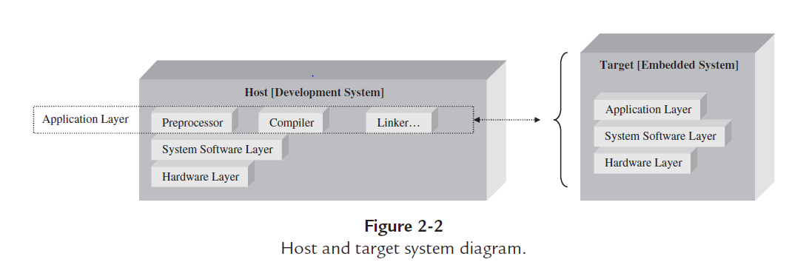
Host and Target system

Slide 29
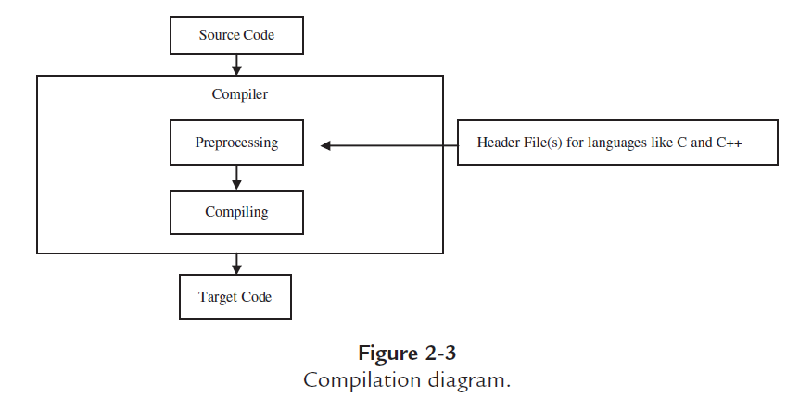

Slide 30
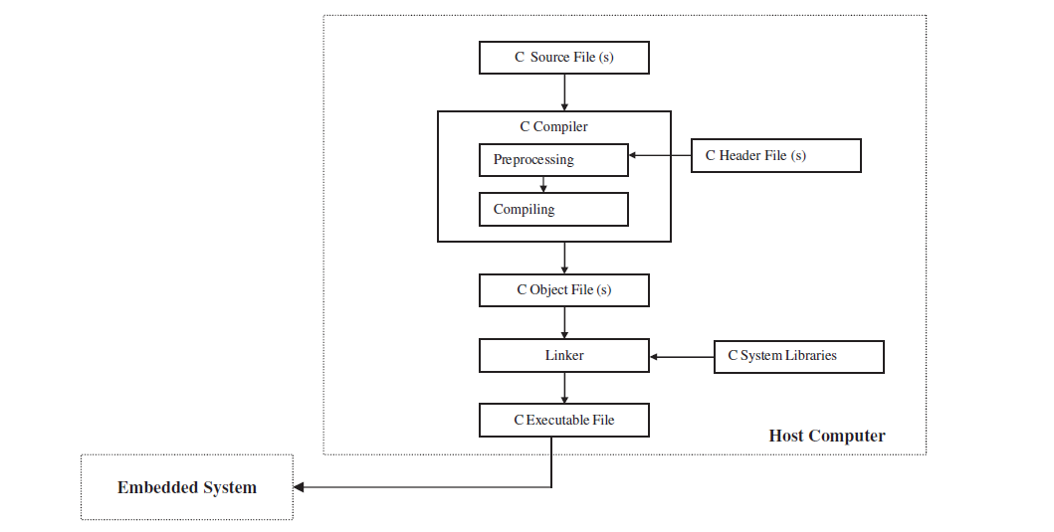

Slide 31
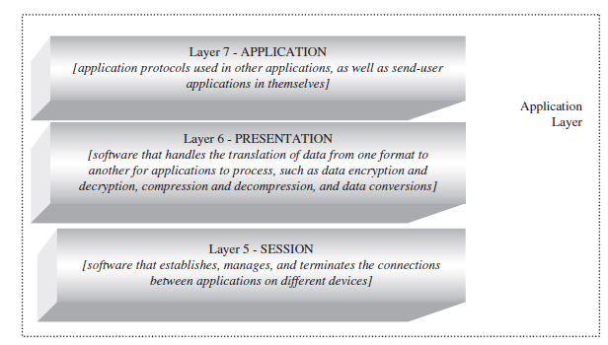
OSI (Open System Interconnection ) Model

Slide 32
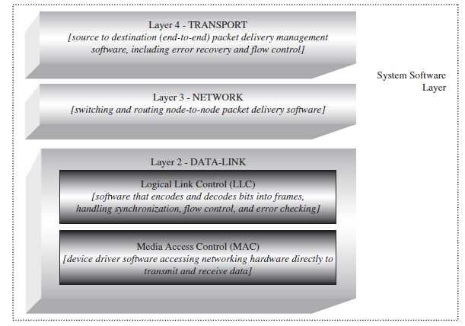
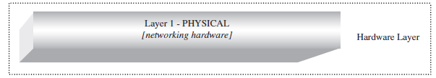

Slide 33
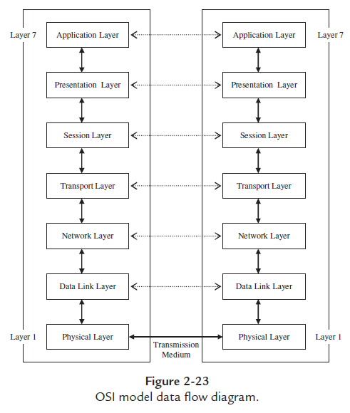

Slide 34
In short, a networking connection starts with data originating at the application layer of one device and flowing downward through all seven layers, with each layer adding a new bit of information to the data being sent across the network. Information, called the header.
Is appended to the data at every layer (except for the physical and application layers) for peer layers in connected devices to process.
The data is then sent over the transmission medium to the physical layer of a connected device and then up through the connected device’s layers.
These layers then process the data (strip the headers, reformat, etc.) as the data flows upward.
The functionality and methodologies implemented at each layer based on the OSI model are also commonly referred to as networking protocols.

Slide 35
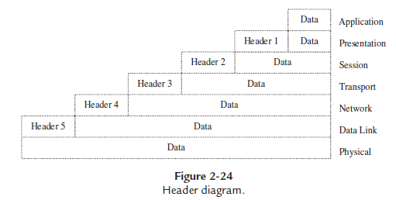

Slide 36
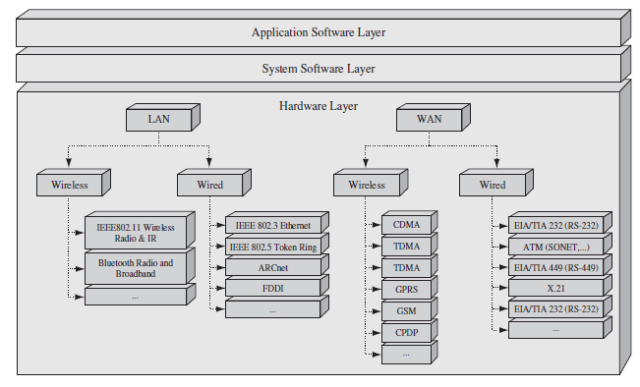
Physical layer protocols in the Embedded Systems Model.

Slide 37
OSI Model Layer 1: Physical Layer
Physical layer protocols defining the networking hardware of the device are located in the hardware layer of the Embedded Systems Model .Physical layer hardware components connect the embedded system to some transmission medium.
The distance between connected devices, as well as the network’s architecture, are important at this layer, since physical layer protocols can be classified as either LAN protocols or WAN protocols.
LAN and WAN protocols can then be further subdivided according to the transmission medium connecting the device to the network (wired or wireless).

Slide 38
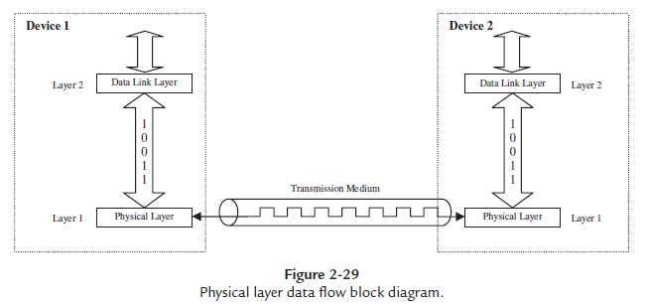

Slide 39
Embedded Hardware
The Embedded Board and the von Neumann Model
At the highest level, the major hardware components of most boards can be classified into five major categories:
Central processing unit (CPU): the master processor.
Memory: where the system’s software is stored.
Input device(s): input slave processors and relative electrical components.
Output device(s): output slave processors and relative electrical components.
Data pathway(s)/bus(es): interconnects the other components, providing a “highway” for data to travel on from one component to another, including any wires, bus bridges, and/or bus controllers.

Slide 40
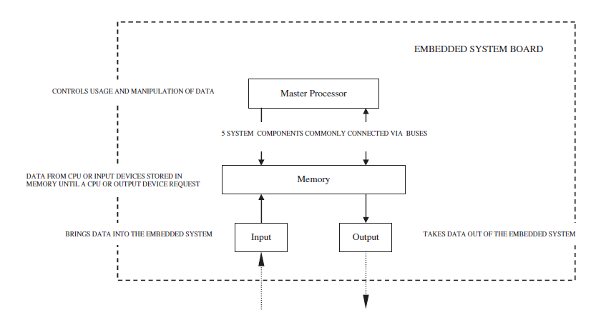

Slide 41
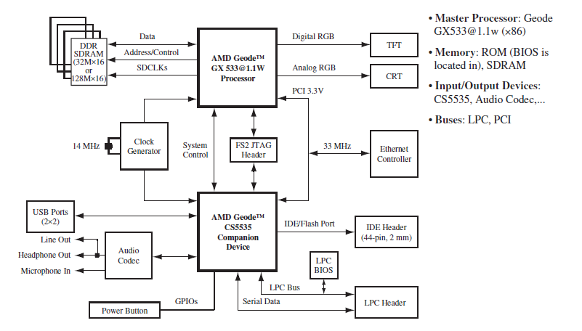
AMD/National Semiconductor ×86 reference board.[1] © 2004 Advanced Micro Devices, Inc.

Slide 42
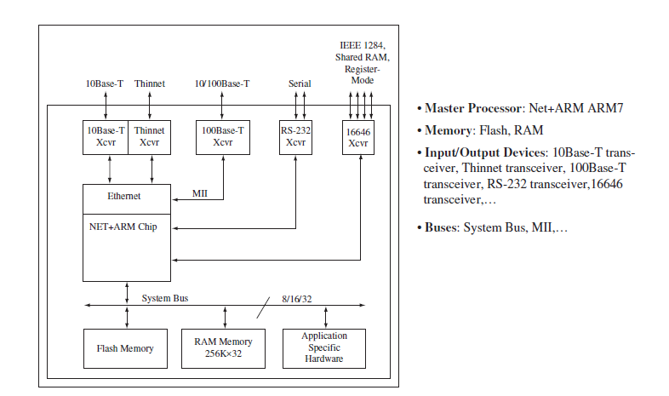
Net Silicon ARM7 reference board.

Slide 43
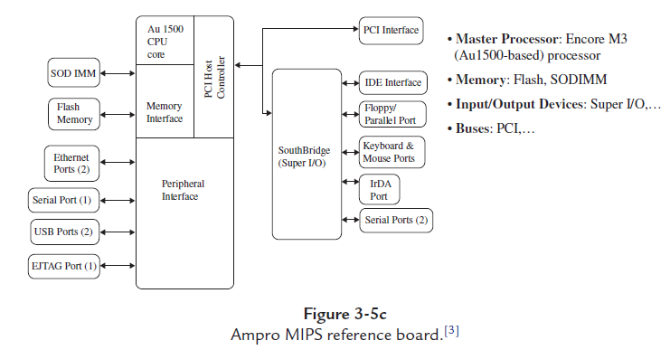
Small Outline Dual in line Memory module

Slide 44
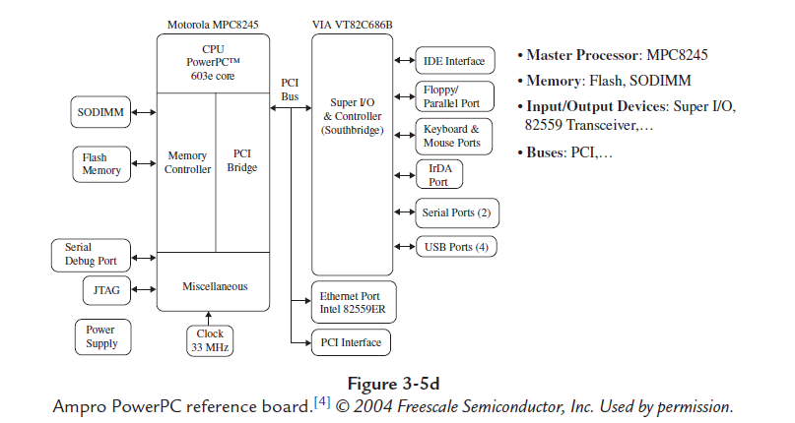

Slide 45
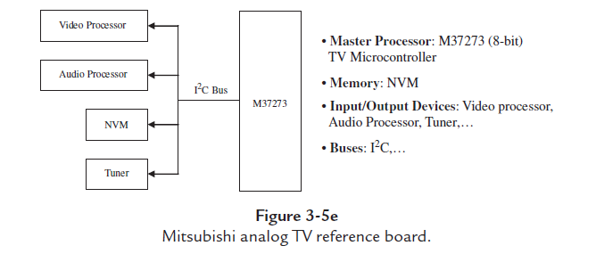

Slide 46
Embedded Processors
Processors are the main functional units of an embedded board, and are primarily responsible for processing instructions and data.
An electronic device contains at least one master processor, acting as the central controlling device, and can have additional slave processors that work with and are controlled by the master processor.
These slave processors may either extend the instruction set of the master processor or act to manage memory, buses, and I/O (input/output) devices.
The complexity of the master processor usually determines whether it is classified as a microprocessor or a microcontroller

Slide 47
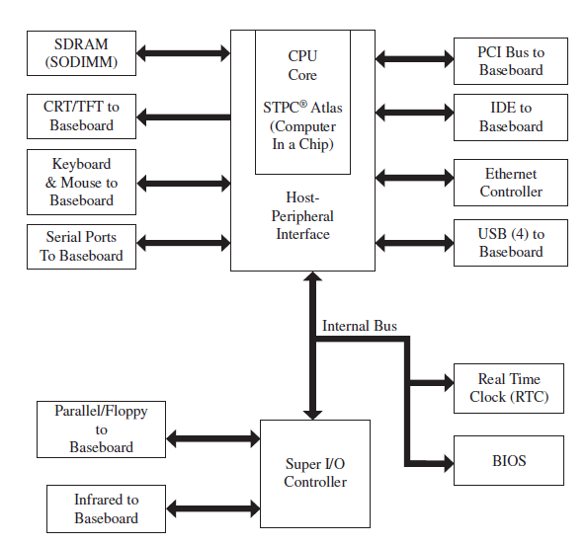
The Atlas STPC is the master processor, and the super I/O and Ethernet controllers are slave processors

Slide 48
ISA Architecture Models
The ISA defines such features as the operations that can be used by programmers to create programs for that architecture.
The operands (data) that are accepted and processed by an architecture, storage, addressing modes used to gain access to and process operands, and the handling of interrupts.
Operations
Operations are made up of one or more instructions that execute certain commands. Different processors can execute the exact same operations using a different number and different types of instructions.

Slide 49
Types of operations. Operations are the functions that can be performed on the data, and they typically include
computations (math operations)
movement (moving data from one memory location/register to another)
branches (conditional/unconditional moves to another area of code to process)
I/O operations (data transmitted between I/O components and master processor)
context switching operations (where location register information is temporarily stored when switching to some routine to be executed and after execution.

Slide 50
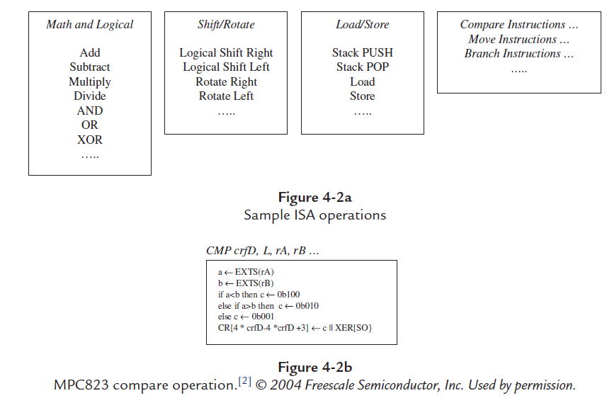

Slide 51
The instruction set on a popular lower-end processor, the 8051, includes just over 100 instructions for math, data transfer, bit variable manipulation, logical operations, branch flow and control, etc.
In comparison, a higher-end MPC823 Motorola/Free scale PowerPC) has an instruction set a little larger than that of the 8051, but with many of the same types of operations contained in the 8051 set along with an additional handful, including integer operations/ floating-point (math) operations, load and store operations, branch and flow control operations, processor control operations, memory synchronization operations, and PowerPC.

Slide 52
Operation formats.
The format of an operation is the actual number and combination of bits (1s and 0s) that represent the operation, and is commonly referred to as the operation code or opcode.
MPC823 opcodes, for instance, are structured the same and are all 6 bits long (0-63 decimal).
MIPS32/MIPS Opcodes are also 6 bits long, but the opcode can vary as to where it is located.
An architecture, like the SA-1100 which is based upon the ARM v4 Instruction Set, can have several instruction set formats depending on the type of operation being performed Operands

Slide 53
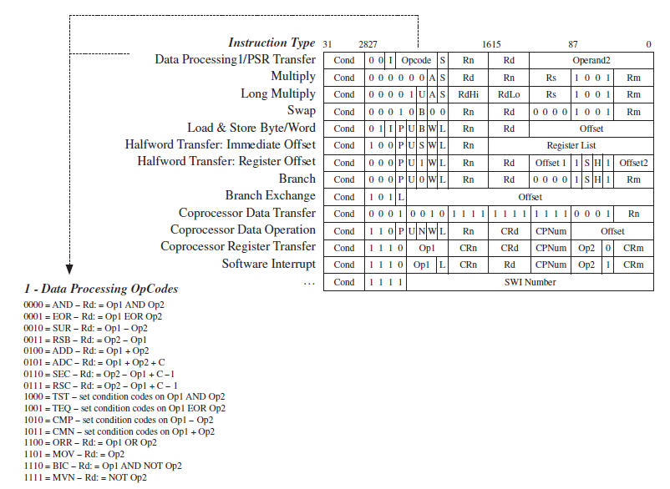

Slide 54
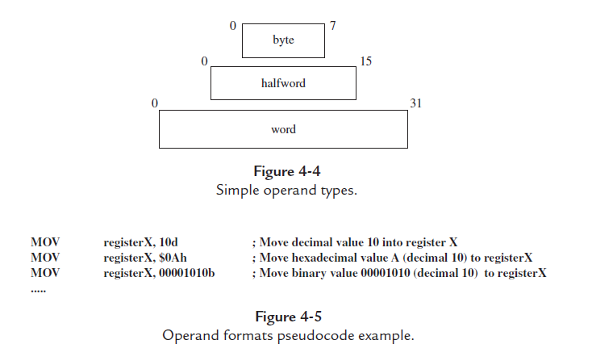

Slide 55
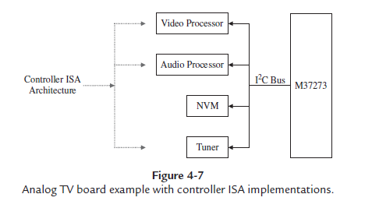
Application-Specific ISA Models
Application-specific ISA models define processors that are intended for specific embedded applications.
1. Controller Model: The Controller ISA is implemented in processors that are not required to perform complex data manipulation, such as video and audio processors that are used as slave processors on a TV board
example:

Slide 56
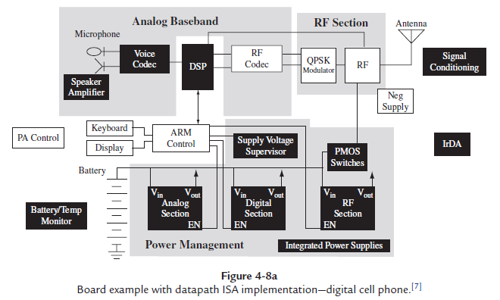
2. Data path Model: The Datapath ISA is implemented in processors whose purpose is to repeatedly perform fixed computations on different sets of data, a common example being digital signal processors (DSPs).

Slide 57
3.Finite-State Machine with Datapath (FSMD) Model:
The FSMD ISA is an implementation based upon a combination of the Datapath ISA and the Controller ISA
processors that are not required to perform complex data manipulation and must repeatedly perform fixed computations on different sets of data.
programmable logic devices (PLDs), and field-programmable gate-arrays (FPGAs, which are essentially more complex PLDs).
FPGAs have emerged as a powerful and sustaining force in embedded systems designs.
At the highest level FPGAs are some combination of interconnected CLBs (configurable logic blocks) to form a more a complex digital circuit.
A wide range of tools are available today to create FPGA custom circuits based on everything from VHDL (type of hardware description language) to Verilog to schematic design techniques.

Slide 58
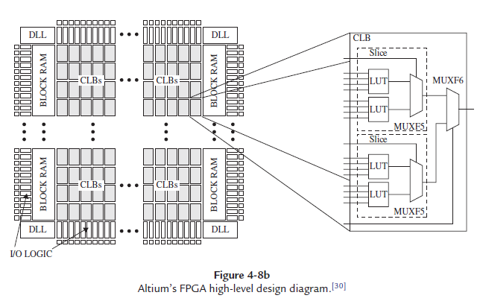

Slide 59
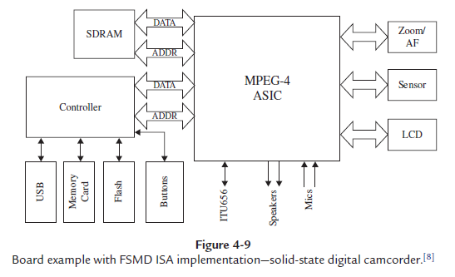

Slide 60
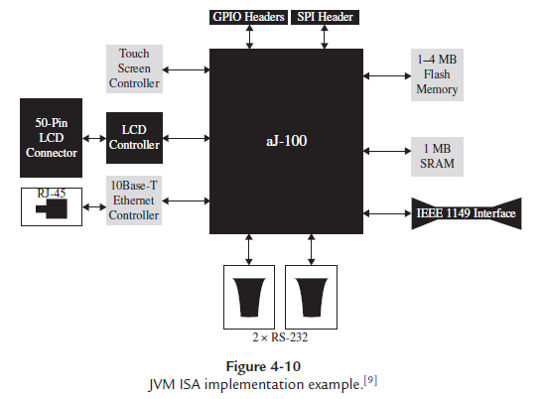
4. Java Virtual Machine (JVM) Model: The JVM ISA is based upon one of the JVM standards . Sun Microsystem’s Java Language.

Slide 61
5.General-Purpose ISA Models:
General-purpose ISA models are typically implemented in processors targeted to be used in a wide variety of systems, rather than only in specific types of embedded systems. The most common types of general-purpose ISA architectures implemented in embedded processors are:
Complex Instruction Set Computing (CISC) Model. The CISC ISA, as its name implies, defines complex operations made up of several instructions.
Examples of architectures:- Intel’s x86 and Motorola/ Freescale’s 68000 families of processors.
Reduced Instruction Set Computing (RISC) Model. In contrast to CISC, the RISC ISA usually defines: an architecture with simpler and/or fewer operations made up of fewer instructions; an architecture that has a reduced number of cycles per available operation. Many RISC processors have only one-cycle operations, whereas CISCs typically have multiple cycle operations.
Examples :- ARM, PowerPC, SPARC, and MIPS are just a few examples of RISC-based architectures.

Slide 62
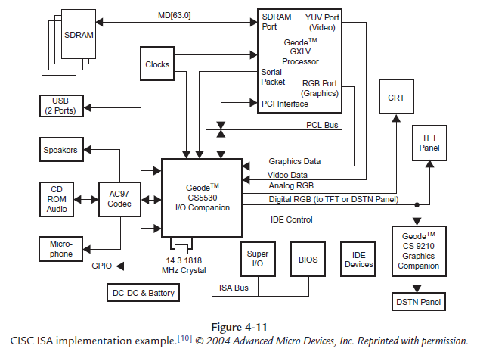

Slide 63
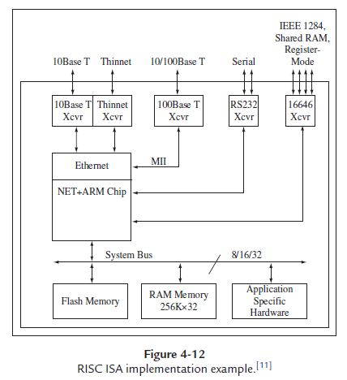

Slide 64
Internal Processor Design & Processor Performance
The ISA defines what a processor can do and it is the processor’s internal interconnected hardware components that physically implement the ISA’s features.
Interestingly, the fundamental components that make up an embedded board are the same as those that implement an ISA’s features in a processor: a CPU, memory, input components, output components, and buses.
A von Neumann architecture defines a single memory space to store instructions and data.
A Harvard architecture defines separate memory spaces for instructions and data; separate data and instruction buses allow for simultaneous fetches and transfers to occur.
The main reasoning behind using von Neumann versus a Harvard-based model for an architecture design is performance.

Slide 65
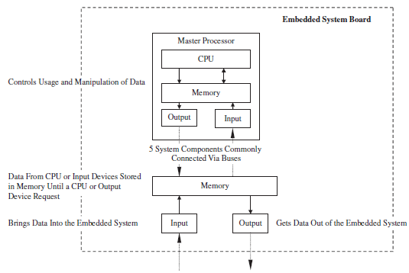
Von- Neumann Architecture

Slide 66
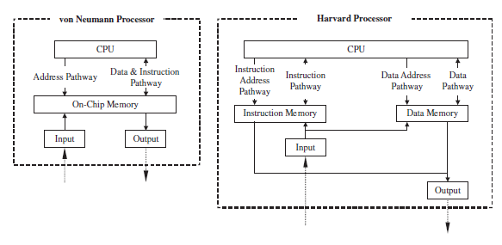
Von- Neumann Vs Harvard Processor

Slide 67
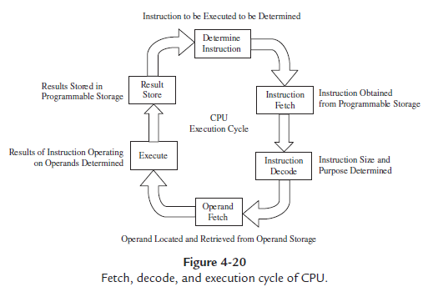
Central Processing Unit (CPU)
The CPU is responsible for executing the cycle of fetching, decoding, and executing. This three-step process is commonly referred to as a three-stage pipeline and most recent CPUs are pipelined designs

Slide 68
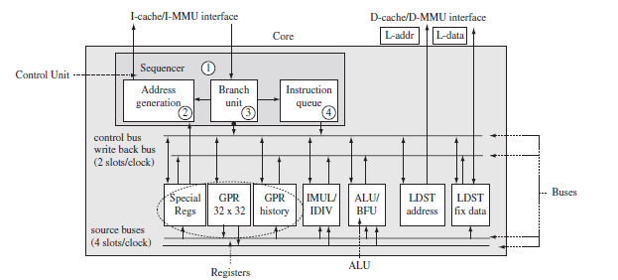
As defined by the von Neumann model, this cycle is implemented through some combination of four major CPU components:
The arithmetic logic unit (ALU): implements the ISA’s operations.
Registers: a type of fast memory.
The control unit (CU): manages the entire fetching and execution cycle.
The internal CPU buses: interconnect the ALU, registers, and the CU.

Slide 69
Board Memory
Memory which is typically located outside of the processor, or that can be either integrated into the processor or located outside the processor.
Memory can be physically integrated on the processor, like registers and certain types of primary memory, which is memory connected directly to or integrated in the processor such as read-only memory (ROM), random access memory (RAM), and level-1 cache.
This includes other types of primary memory, such as ROM, level 2+ cache, and main memory, and secondary/tertiary memory, which is memory that is connected to the board but not the master processor directly, such as CD-ROM, floppy drives, hard drives, and tape.

Slide 70
Primary memory is typically a part of a memory subsystem made up of three components:
1.The memory IC.
2.An address bus.
3.A data bus.
In general, a memory IC is made up of three units:
i) the memory array,
ii) the address decoder,
iii) the data interface.
The memory array is actually the physical memory that stores the data bits.
While the master processor, and programmers, treat memory as a one-dimensional array, where each cell of the array is a row of bytes and the number of bits per row can vary.
In reality physical memory is a two-dimensional array made up of memory cells addressed by a unique row and column, in which each cell can store 1 bit

Slide 71
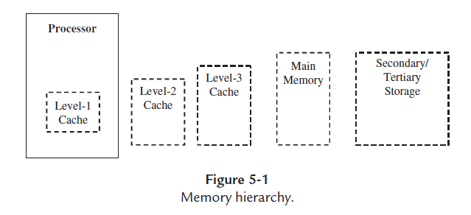
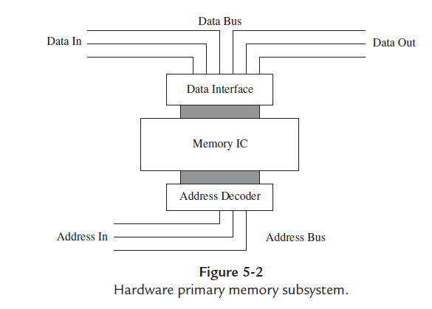

Slide 72
Memory ICs that can connect to a board come in a variety of packages, depending on the type of memory.
Types of packages include
dual in-line packages (DIPs),
single in-line memory modules (SIMMs),
dual in-line memory modules (DIMMs).

Slide 73
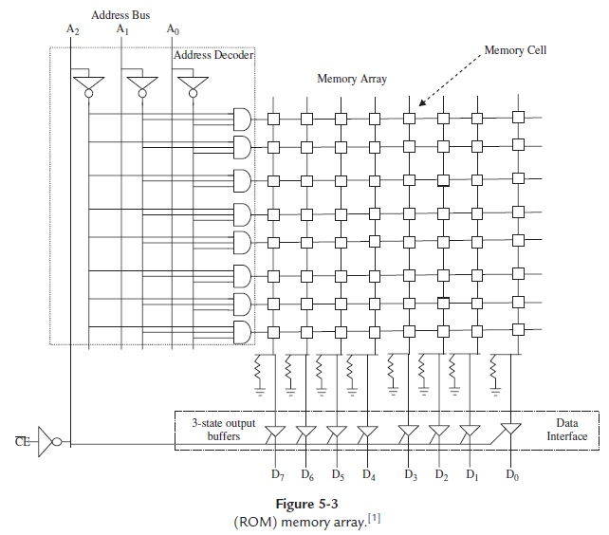

Slide 74
At the highest level, both primary and secondary memory can be divided into two groups, non-volatile or volatile.
Non-volatile memory is memory that can store data after the main power source to the board has been shut off (usually due to a small, on-board, longer-life battery source).
Volatile memory loses all of its “bits” when the main power source on the board has been shut off.
On embedded boards, there are two types of non-volatile memory families—ROM and auxiliary memory—and one family of volatile memory, RAM.

Slide 75
ROM- Read Only Memory
ROM is a type of non-volatile memory that can be used to store data on an embedded system permanently, typically through a smaller on-board battery source that is separate from the board’s main power source.
The type of data stored on ROM in an embedded system is (at the very least) the software required by the device to function in the field after being shipped out of the factory.
The contents of ROM can typically only be read by the master processor; however, depending on the type of ROM, the master processor may or may not be able to erase or modify the data located in ROM.

Slide 76
RAM- Random Access Memory
RAM commonly referred to as main memory, any location within it can be accessed directly and randomly, rather than sequentially from some starting point, and its content can be changed more than once—the number of times depending on the hardware. Unlike ROM, contents of RAM are erased if the board loses power, meaning RAM is volatile. The two main types of RAM are static RAM (SRAM) and dynamic RAM (DRAM).

Slide 77
Level 2+ Caches
Level 2+ (level 2 and higher) cache is the level of memory that exists between the CPU and main memory in the memory hierarchy . cache that is external to the processor is introduced (i.e., caches higher than level 1).
SRAM memory is usually used as external cache (like level 1 cache), because the purpose of cache is to improve the performance of the memory system, and SRAM is faster than DRAM.
Using cache became popular in response to systems that displayed a good locality of reference, meaning that these systems, in a given time period, accessed most of their data.

Slide 78
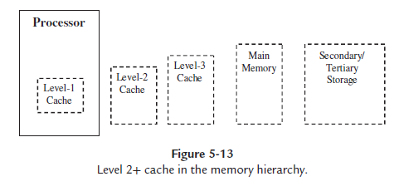

Slide 79
When the CPU wants to read data from memory, level 1 cache is checked first. If the data is in cache, it is called a cache hit, the data is returned to the CPU and the memory access process is complete.
If the data is not located in level 1 cache, it is called cache miss. External off-chip caches are then checked and if there is a miss there also, then on to main memory to retrieve and return the data to the CPU.
Data is usually stored in cache in one of three schemes:
i) direct mapped,
ii) set associative,
iii) full associative.

Slide 80
i) Direct mapped :- In the direct mapped cache scheme, addresses in cache are divided into sections called blocks. Every block is made up of the data, a valid tag (flag indicating if block is valid), and a tag indicating the memory address(es) represented by the block.
ii) Set associative :- The set associative cache scheme is one in which cache is divided into sections called sets and within each set, multiple blocks are located at the set level.
iii) full associative :- The full associative cache scheme, like the set associative cache scheme, is also composed of blocks. In the full associative scheme, however, blocks are placed anywhere in cache and must be located by searching the entire cache every time.

Slide 81
The most common cache selection and replacement schemes include:
Optimal, using future reference time, swapping out pages that won’t be used in the near future.
Least Recently Used (LRU), which swaps out pages that were used the least recently.
First In First Out (FIFO), another scheme that, as its name implies, swaps out the pages that are the oldest, regardless of how often they are accessed in the system. While a simpler algorithm then LRU, FIFO is much less efficient.
Not Recently Used (NRU), which swaps out pages that were not used within a certain time period.
Second Chance, a FIFO scheme with a reference bit, if “0” will be swapped out (a reference bit is set to “1” when access occurs, and reset to “0” after the check).
Clock Paging, pages being replaced according to clock (how long they have been in memory), in clock order, if they haven’t been accessed (a reference bit is set to “1” when access occurs, and reset to “0” after the check).

Slide 82
Level 2+ Caches
 | Main Memory | Video Memory | Cache
SRAM |  |  | BSRAM (Burst/SynchBurst Static Random Access Memory) is a type of SRAM that is synchronized with either the system clock or a cache bus clock.

Slide 83
 | Main Memory | Video Memory | Cache
DRAM | SDRAM (Synchronous Dynamic RAM) is DRAM that is synchronized with the microprocessor’s clock speed (in MHz). used in various systems, such as the JDEC SDRAM (JEDEC Synchronous Dynamic RAM), PC100 SDRAM (PC100 Synchronous Dynamic RAM), and DDR SDRAM (Double Data Rate Synchronous Dynamic RAM). ESDRAM (Enhanced Synchronous Dynamic RAM) | RDRAM (On-Chip Rambus Dynamic RAM) and MDRAM (On-Chip Multibank Dynamic RAM) are DRAMs commonly used as display memory that store arrays of bit values (pixels of the image on thedisplay). The resolution of the image is determined by the number of bits that have been defined per each pixel. | Enhanced Dynamic Random Access Memory (EDRAM) actually integrates SRAM within the DRAM and is usually used as level 2 cache. The faster SRAM portion of EDRAM is searched first for the data, and if not found there, then the DRAM portion of EDRAM is searched.

Slide 84
 | Main Memory | Video Memory | Cache
DRAM | DRDRAM (Direct Rambus Dynamic RAM) and SLDRAM (SyncLink Dynamic RAM) are DRAMs whose bus signals can be integrated and accessed on one line, thus decreasing the access time (since synchronizing operations on multiple lines are not necessary). | Video RAM (VRAM) is DRAM in which the refresh buffer is duplicated and connected to the outside world as a second, serial I/O port. A line of data can be fetched from the memory in parallel. If the RAM contains pixel values, then this sequence nicely corresponds to a scan line on a monitor and facilitates display generation. At the same time, the master processor can access the RAM normally with almost no interference.

Slide 85
 | Main Memory | Video Memory | Cache
DRAM | FRAM (Ferroelectric Random Access Memory) is non-volatile DRAM, meaning data isn’t lost from DRAM when power is shut off. FRAM has a lower power requirement then other types of SRAM, DRAM, and some ROMs (Flash), and is targeted for smaller handheld devices (PDAs, phones, etc.). | FPM DRAM (Fast Page Mode Dynamic Random Access Memory), EDORAM/ EDO DRAM (Data Output Random Access/Dynamic Random Access Memory),and BEDO DRAM (Data Burst Extended Data Output Dynamic Random Access Memory) …

Slide 86
 | Main Memory | Video Memory | Cache
DRAM | FPM DRAM (Fast Page Mode Dynamic Random Access Memory), EDORAM/ EDO DRAM (Data Output Random Access/Dynamic Random Access Memory), and BEDO DRAM (Data Burst Extended Data Output Dynamic Random Access Memory) …

Slide 87
Small Microcontrollers. Approaches to Embedded Systems
Many different approaches can be taken for the design of embedded systems.
The general trend is toward digital systems and increasing integration: Systems that used analog electronics or small-scale integrated circuits (ICs) in the past are now more likely to use larger digital ICs.

